Slide 1



Slide 2
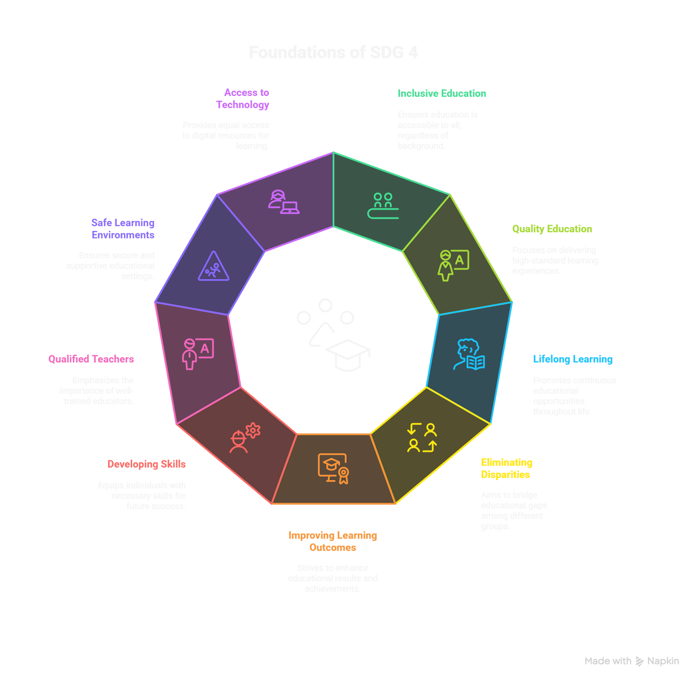

SDG 4: QUALITY EDUCATION

Slide 3
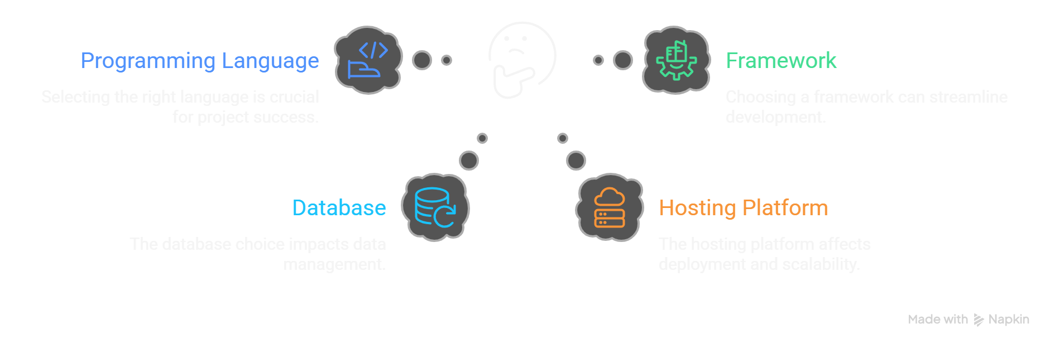
Problem Statement
Overwhelming Choices
Freshers struggle to choose from countless programming languages, frameworks, databases, and hosting platforms.
Conflicting Guidance
Advice from peers, YouTube, and online forums is often contradictory, leading to confusion and indecision.
Wasted Time & Incomplete Projects
Beginners frequently invest time learning unsuitable tools, resulting in frustration and abandoned projects.
Lack of Structured Support
There is a strong need for a reliable, beginner-friendly system to guide learners in selecting the right tech stack for their goals.

Slide 4
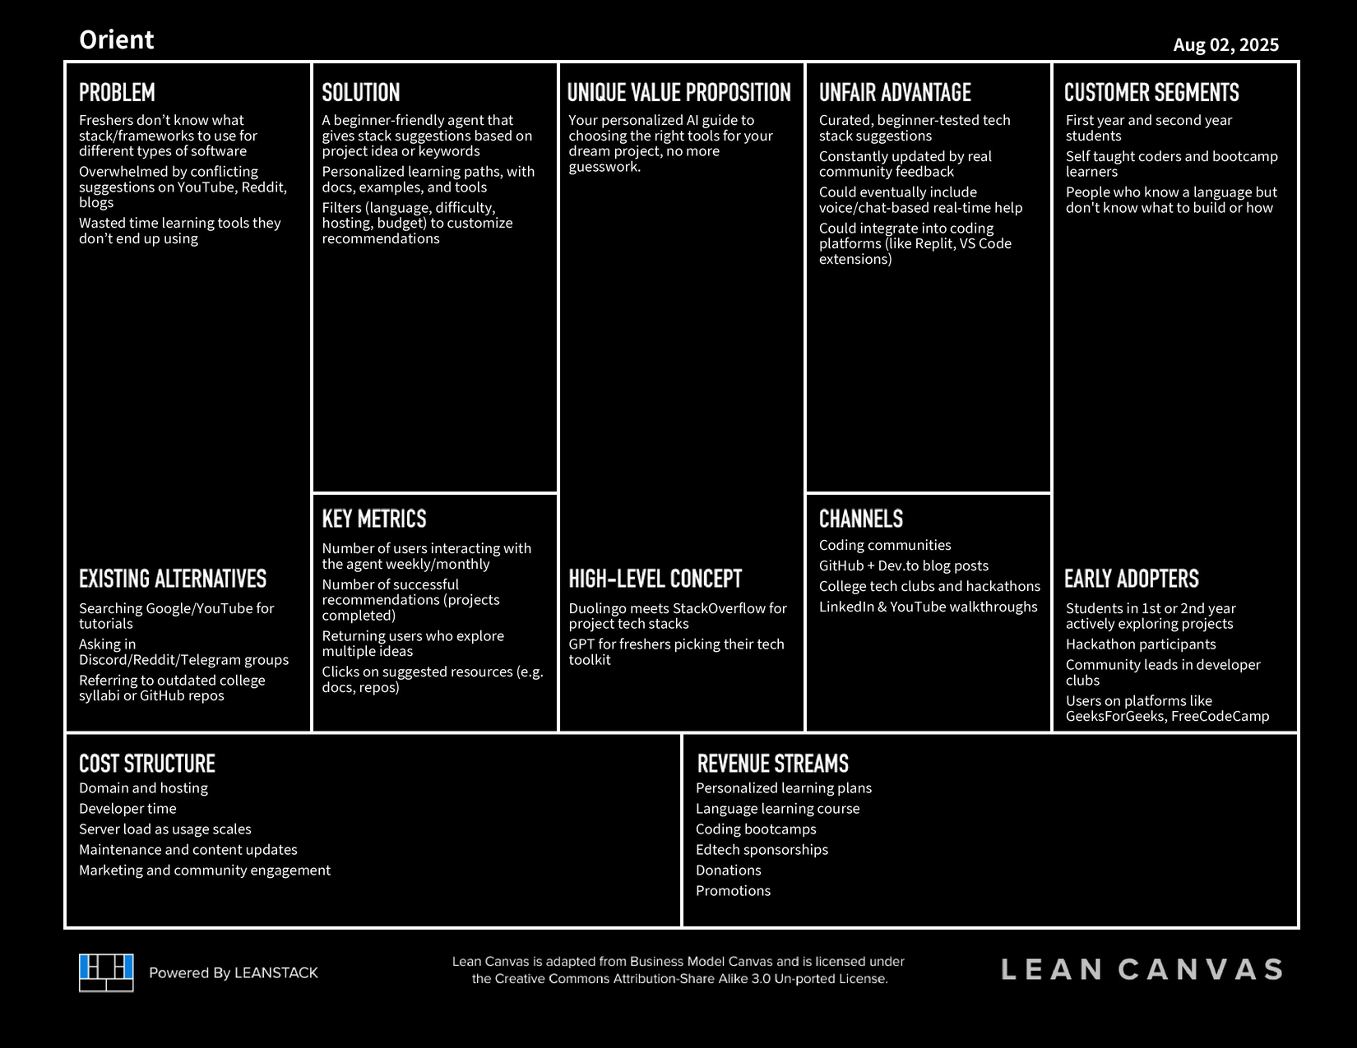
LEAN CANVAS
Freemium with premium upgrade tier
Unlimited queries for subscribers
Affiliate income via bootcamps
Sell templates, kits, eBooks
Paid Discord with expert sessions
Sponsorships from dev companies
Hiring and placement referrals
AI stack API for B2B
Donations via GitHub or UPI
Monetized coding events & hackathons
Click here to open the Lean Canvas

Slide 5
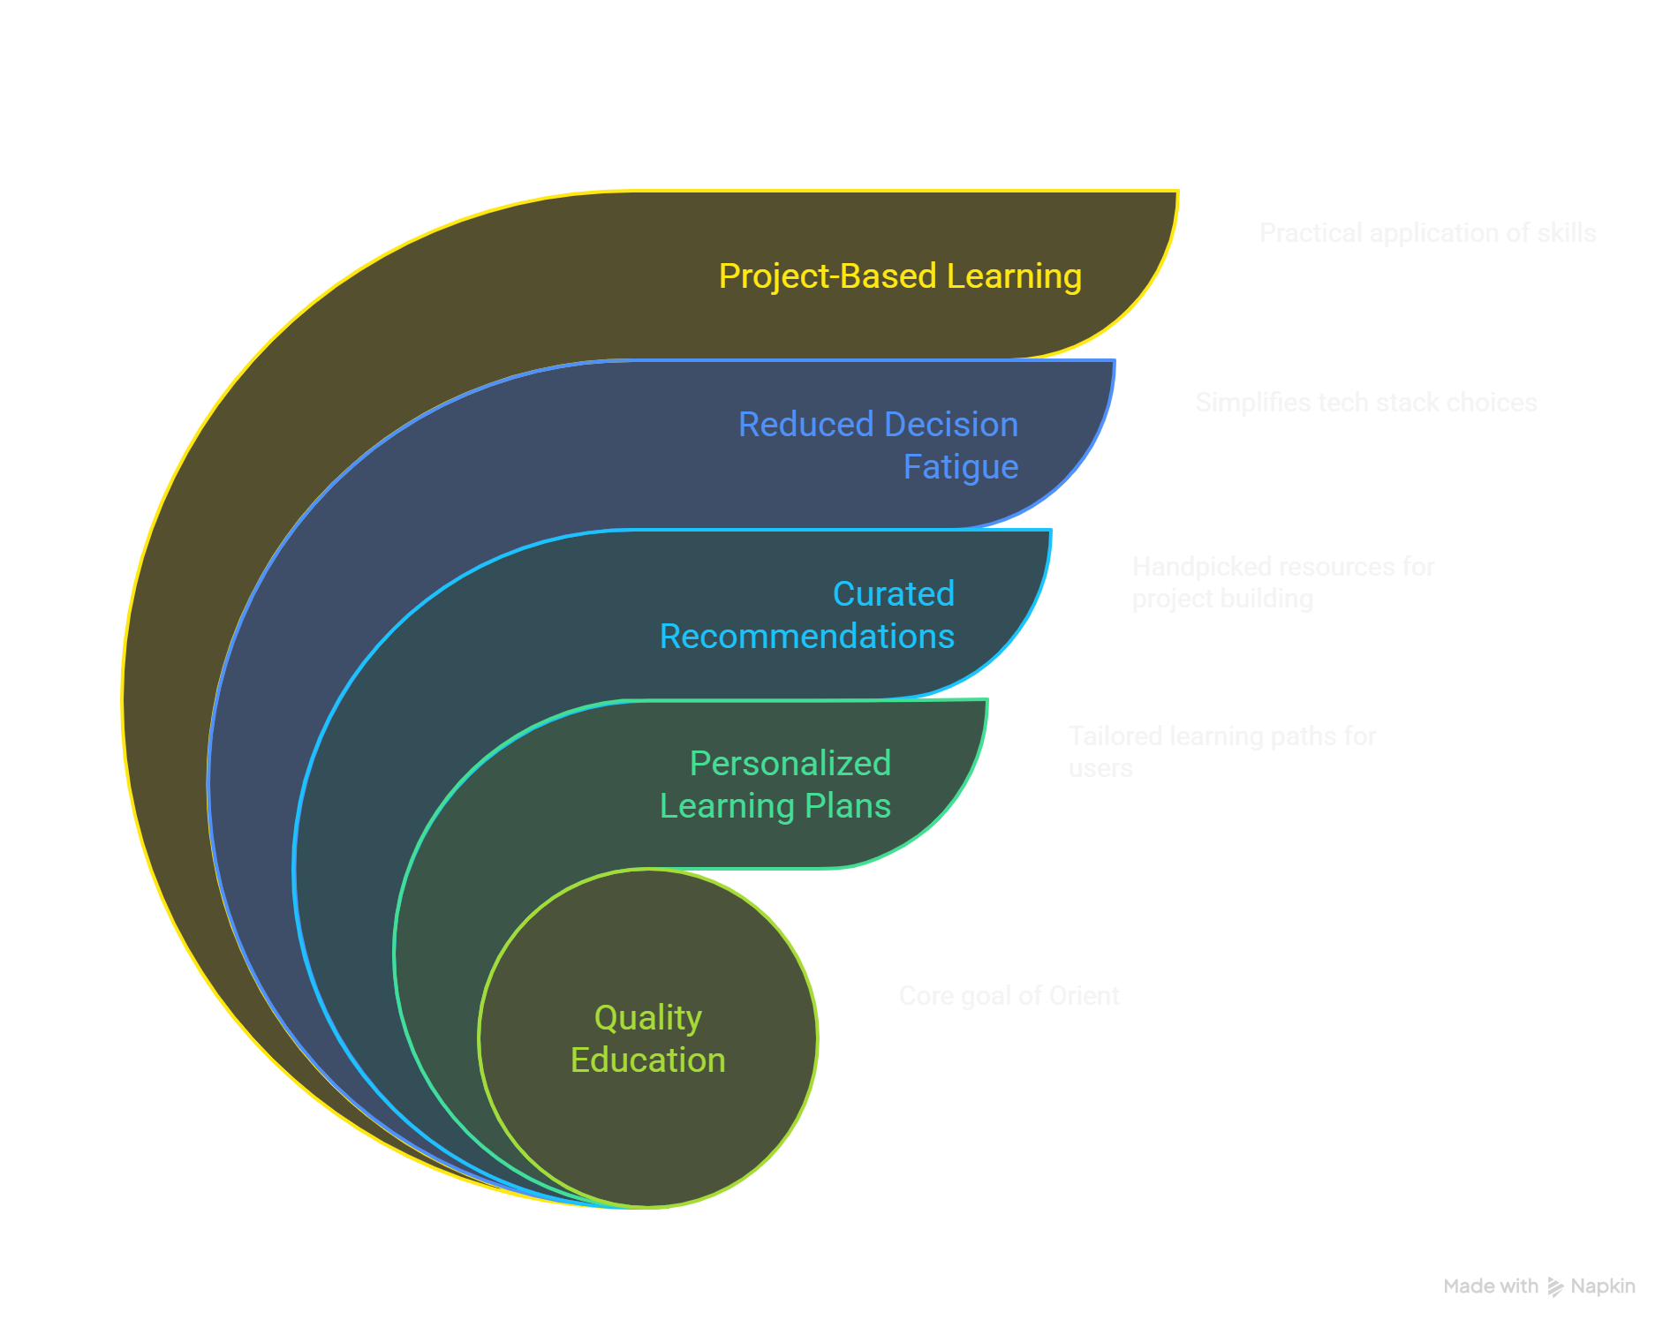
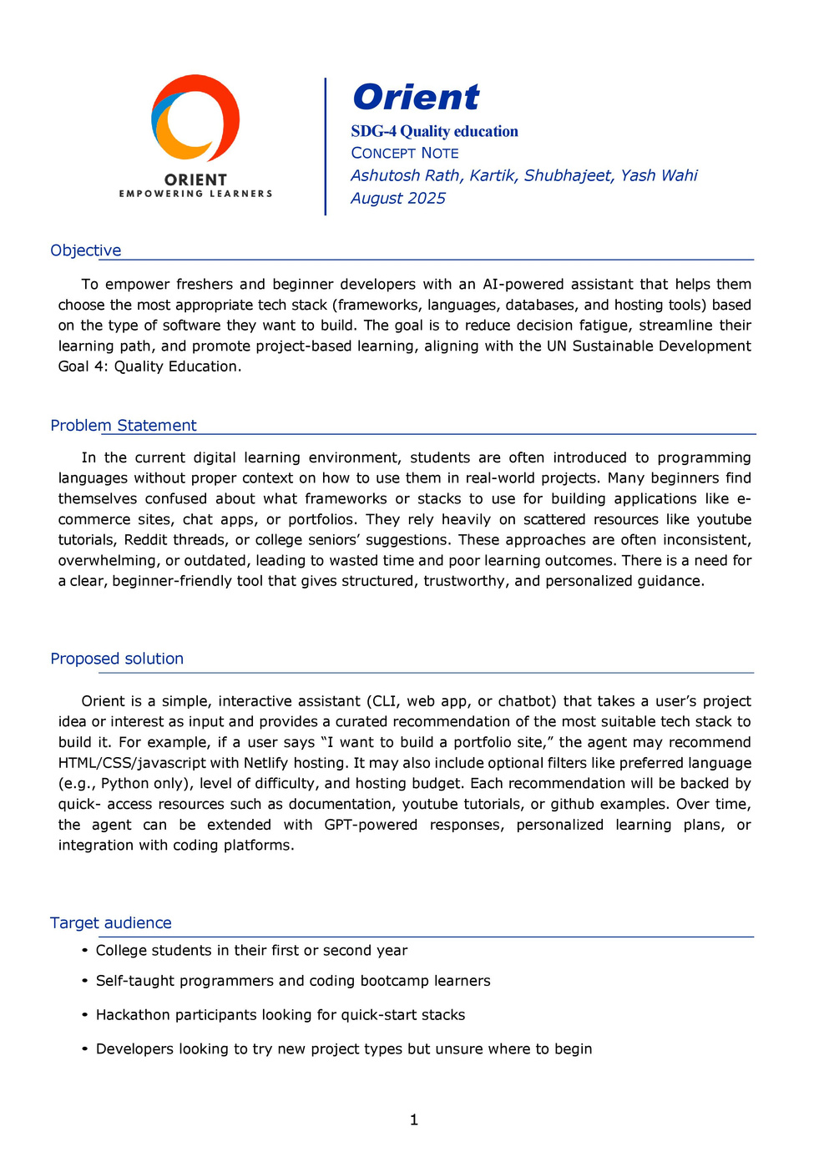
CONCEPT NOTE
Click here to open the Concept Note

Slide 6
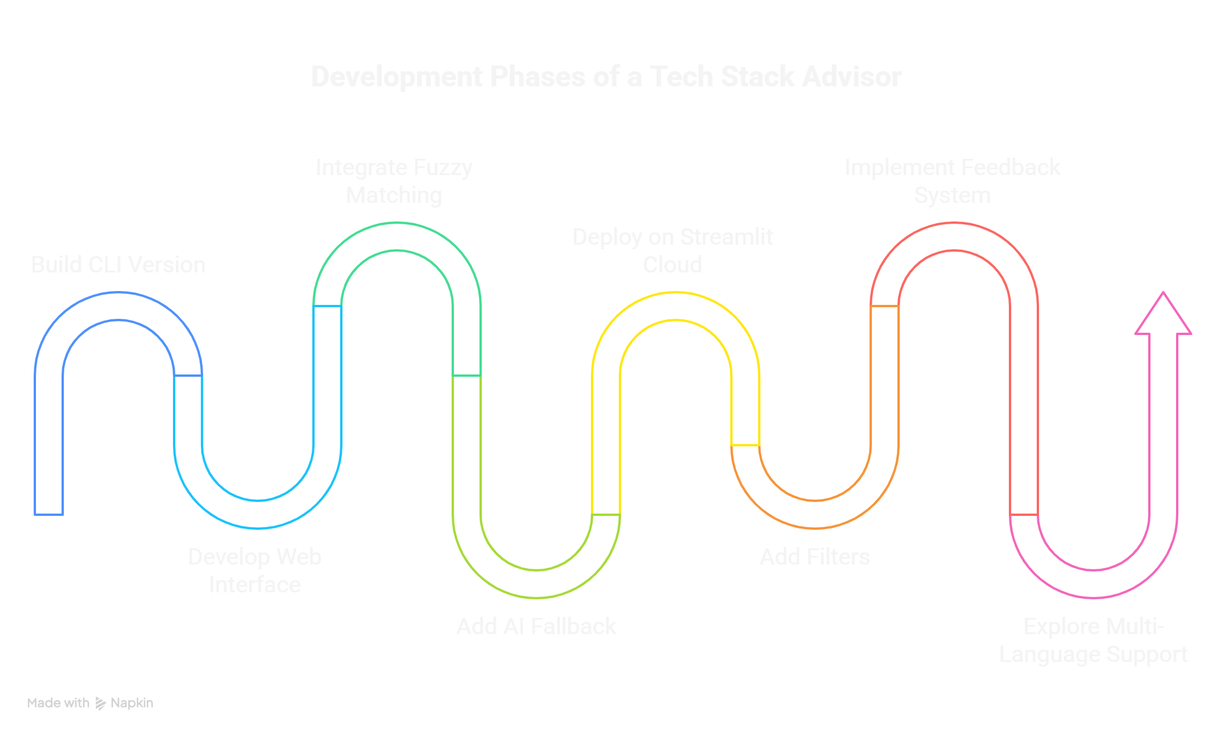
Resources and Roadmap
Click here to open the Agent

